Slide 1
Biology Slideshow: Immune and Integumentary Systems Interaction
How they fight against germs and pathogens

Slide 2
Integumentary System
The integumentary system includes the skin, hair, nails, and glands.
Functions: Protection, regulation of body temperature, sensation, excretion, vitamin D synthesis.

Slide 3
Immune System
The immune system defends the body against infections and diseases.
Components: Innate immunity (skin, mucous membranes) and adaptive immunity (T cells, B cells).

Slide 4
Interaction between Immune and Integumentary Systems
The skin acts as the first line of defense (physical barrier).
Immune cells in the skin (Langerhans cells) detect pathogens and initiate immune response.
Wounds can allow pathogens to enter, triggering immune response.

Slide 5
Fighting against Germs and Pathogens
Physical barriers: Skin prevents entry of microbes.
Chemical barriers: Sweat, sebum kill bacteria.
Immune response: Phagocytes engulf pathogens, antibodies neutralize toxins.

Slide 6
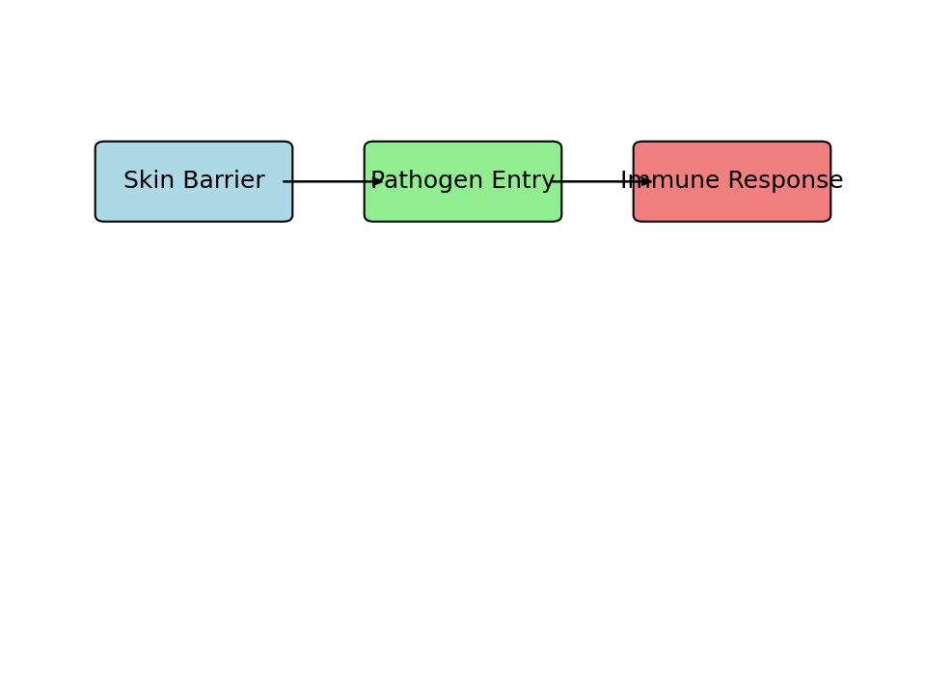
Model of How Systems Fight Pathogens

Slide 7
Conclusion
The integumentary and immune systems work together to protect the body from pathogens.
The skin provides a physical barrier, while the immune system provides cellular and humoral defenses.

